Slide 1
SAP BTP Extension Suite Training
Day 4
Anubhav Oberoy
www.AnubhavTrainings.com
Follow excellence with sheer passion

Slide 2


DISCLAIMER
The training content and delivery of this presentation is confidential, and cannot be recorded, or copied and distributed to any third party, without the written consent of Anubhav Trainings

Slide 3
Agenda – Day 4
01
04
Introduction to CDS Views
Introduction to Fiori Elements
02
05
Business Application Studio
Adding UI module
03
06
Generic Service handlers & Test
Deploy App to CF

Slide 4
Introduction to CDS Views
1. Usually we have all our data distributed across multiple tables, and if we need to get this data out, we need to write complex queries with joins. It becomes very complex to handle the maintenance of these large queries. Views will simplify the consumption and make it easy to maintenance.
2. We can perform operations like aggregation on the view.
3. Security
4. CDS views are also the contracts for data consumption
5. They include annotations which drive functionality.
6. View provide lose coupling to load data. Whereas when we use queries and joins, they are always tight coupling.
Exercise:
https://github.com/soyuztechnologies/SAP_BTP_Training_CLD200/blob/master/Day%203/01%20db/01db/CDSViews.cds
Purchase order
Purchase order items
Load what is needed

Slide 5
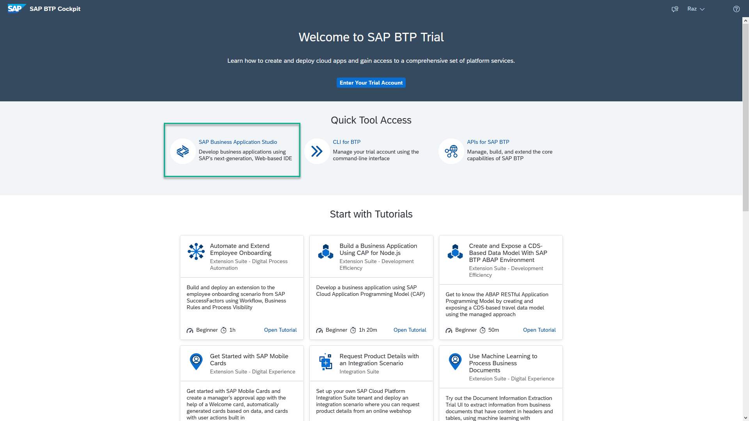
Business Application Studio
SAP Business Application Studio is a development environment available on SAP Business Technology Platform. Before you can start developing using SAP Business Application Studio, administrators must perform the required onboarding steps that are described in this tutorial.
In an Enterprise Account you can set up SAP Business Application Studio as a Free-Tier service by checking its free plan during its entitlement configuration.

Slide 6
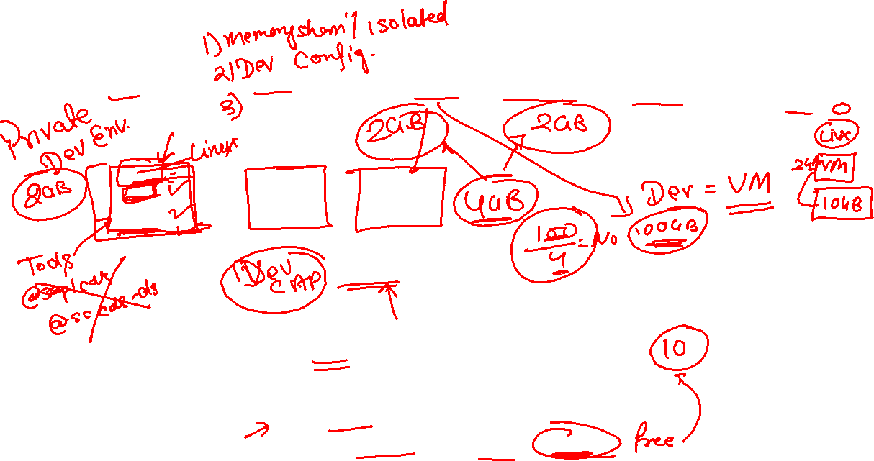
Dev Space in BAS
VM
2GB
Dev Space
@cds/dk
VM
2GB
Business Application Studio
PaaS – BTP – Manager of this entire infrastructure
IaaS – AWS – Computer Running on internet
Bunch of servers with hardware – 1000 GB

Slide 7


Hands on: Move App to BAS

Slide 8
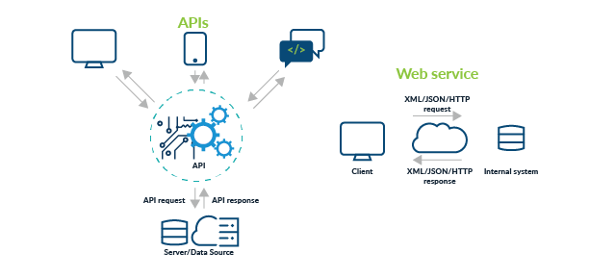
Testing Services in BAS
Exercise:
https://github.com/soyuztechnologies/SAP_BTP_Training_CLD200/blob/master/Day%203/02srv/tester.http

Slide 9
Actions and Functions
In addition to common CRUD operations, you can declare domain-specific custom operations as shown below. These custom operations always need custom implementations in corresponding events handlers.
Actions vs Functions
The differentiation between Actions and Functions stems from the OData specifications and in essence is as follows:
Actions are meant for operations, which add or modify data in the server; they are called through POST request with the arguments passed in application/json bodies.
Functions are meant for operations, which only retrieve data from the server; they are called through GET requests with the arguments passed in the URL path.
Exercise:
https://github.com/soyuztechnologies/SAP_BTP_Training_CLD200/blob/master/Day%203/02srv/CatalogService.cds
https://github.com/soyuztechnologies/SAP_BTP_Training_CLD200/blob/master/Day%203/02srv/CatalogService.js

Slide 10
Generic Handlers in CAP
The CAPM framework generates most of the code to perform CURDQ operations on the entity. It does not know what validations to perform on our business data. As a developer, when we want to attach a pre-check (validations) / post-check (post processing code) on an entity operation, we can use generic handlers. All these operations are performed SYNCHRONOUSLY.
At times we want to
Take full control of our implementation
We want to add some validation before data is inserted or updated
We want to change data before insert/update
Read some extra information while GET calls
Fiori app
odata
cap
Generic handlers
database
before
on
after

Slide 11

Hands on: Generic Handlers

Slide 12
Exercise – generic handlers
Exercise:
https://github.com/soyuztechnologies/SAP_BTP_Training_CLD200/blob/master/Day%203/02srv/MyService.cds
https://github.com/soyuztechnologies/SAP_BTP_Training_CLD200/blob/master/Day%203/02srv/MyService.js

Slide 13
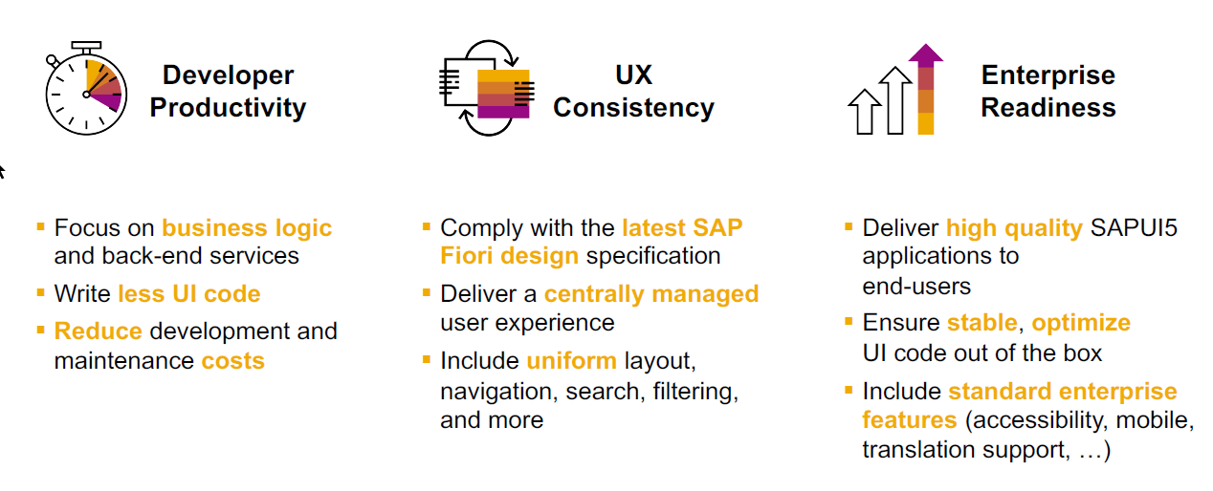
SAP Fiori elements boosts SAP Fiori development efficiency

Slide 14
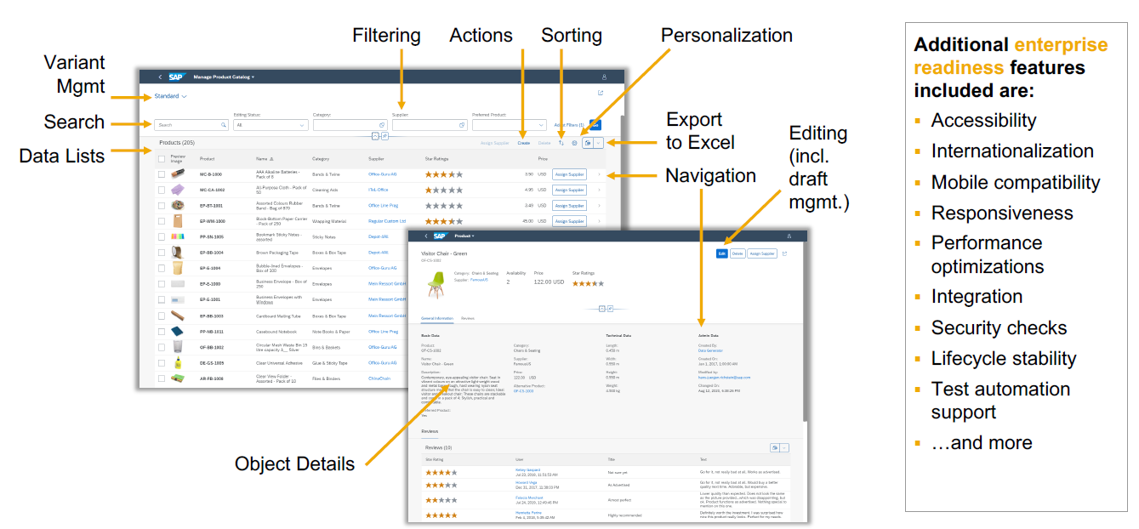
SAP Fiori elements provides enterprise-ready apps out of the box

Slide 15
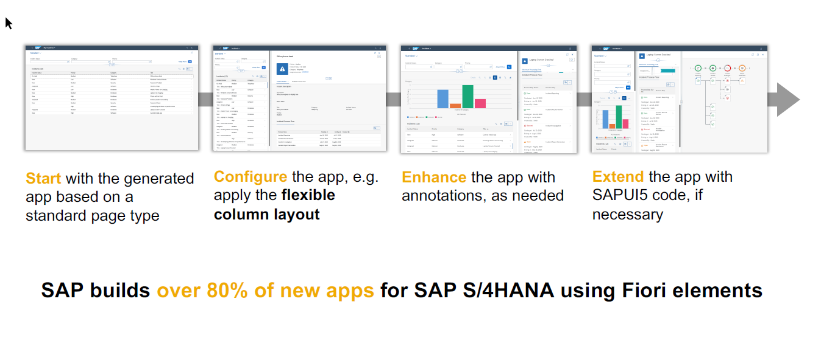
SAP Fiori elements application architecture provides flexibility

Slide 16
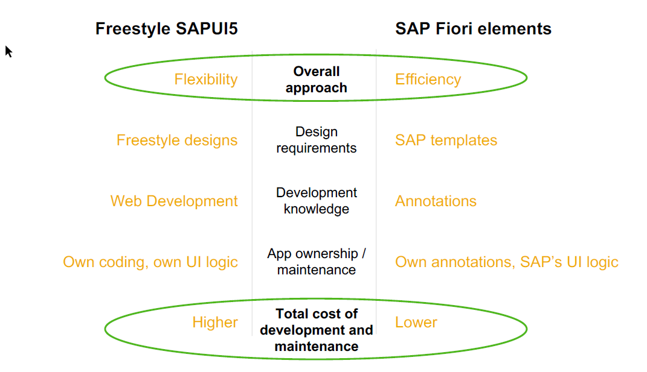
SAP Fiori elements prioritizes efficiency over flexibility

Slide 17

Hands on : Fiori App

Slide 18
Create Fiori App using Annotation
Exercise:
https://github.com/soyuztechnologies/SAP_BTP_Training_CLD200/blob/master/Day%203/03%20application/03application/app/purchaseorderapp/annotations.cds

Slide 19
Association v.s Composition
Association – a relationship between entities which is a lose coupling. Both objects should exist together. However, they can work independently. Airplane and passenger.
Composition – a relationship between entities which is a tight coupling. Both objects must exist together. They cannot function independently. Airplane and wings.
Purchase Order Header
composition
Purchase order Items

Slide 20

Hands on: Create & F4 Enablement for app
Solution: https://github.com/soyuztechnologies/SAP_BTP_Training_CLD200/tree/master/Day%204/capm%20draft%20and%20value%20helps

Slide 21
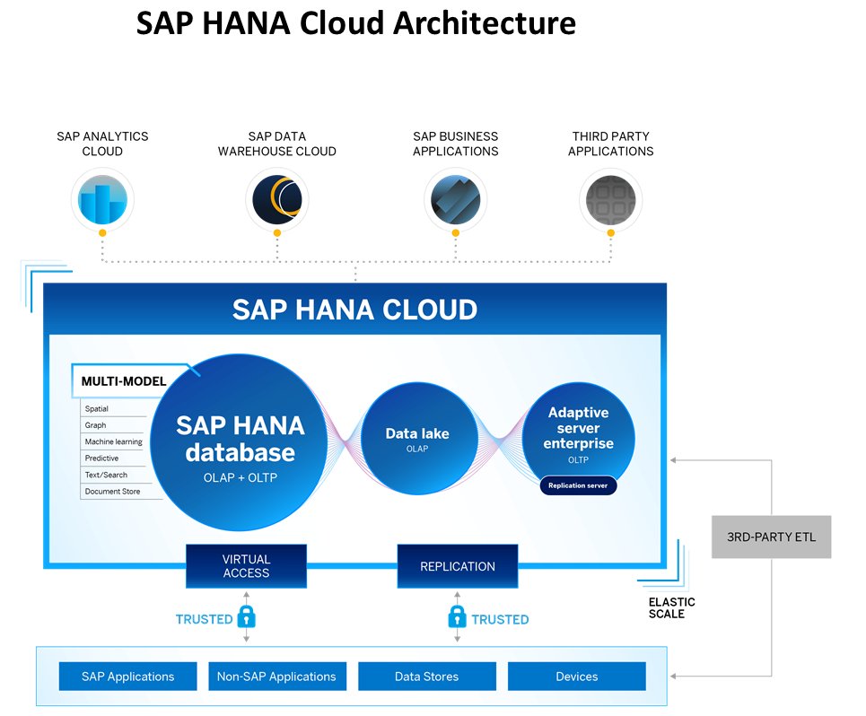
Introduction to HANA Cloud
SAP HANA Cloud is a fully managed, in-memory, cloud database as a service (DBaaS). It is the cloud-based data foundation for SAP Business Technology Platform. With SAP HANA Cloud you can create, run, and extend new and existing applications.
SAP HANA Cloud includes a number of software components. The core component is SAP HANA Database, but other components can be added at any time, such as a data lake.
Key Components of SAP HANA Cloud
There are four key components of SAP HANA Cloud:
SAP HANA Cloud, SAP HANA Database
In-memory database with built-in advanced analytics (spatial, graph, text, etc.)
SAP HANA Cloud, data lake
Store and query large data sets and most file types
SAP HANA Cloud, adaptive server enterprise
Support for extreme –performance transactional applications
SAP HANA Cloud, adaptive server enterprise replication
Bi-directional real time data replication across databases

Slide 22
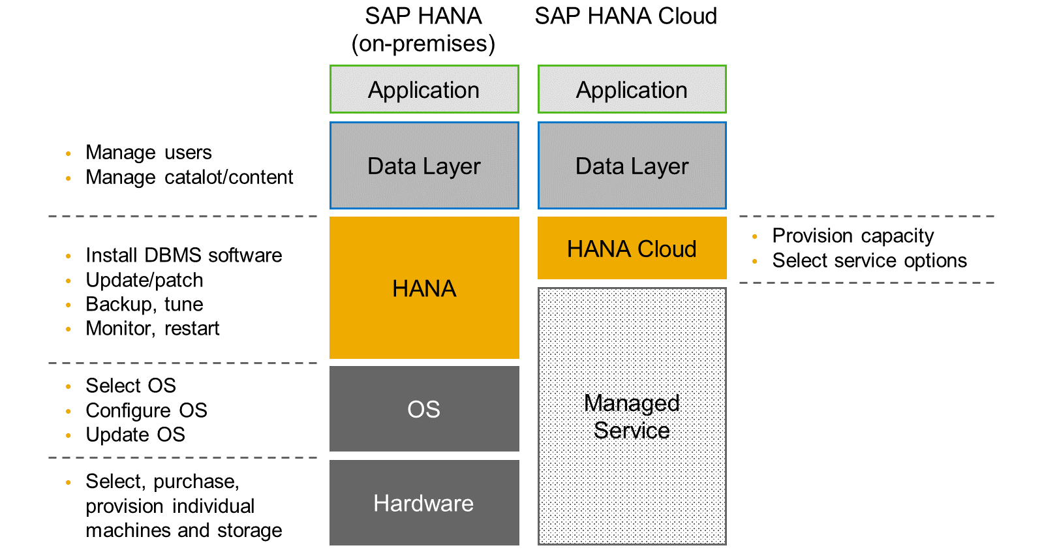
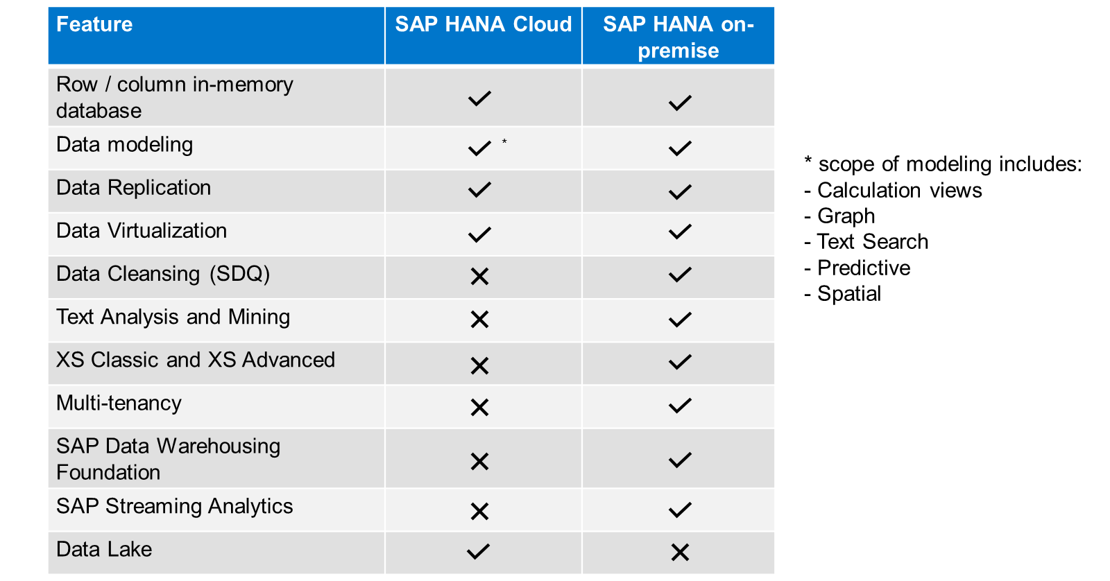
HANA Cloud v/s On-premise
Feature Differences
SAP HANA Cloud compares very closely with SAP HANA on-premise in terms of features but there are some differences.

Slide 24

What We Did
Let’s Summarize

Slide 25

www.anubhavtrainings.com
Thank You
End of Day 4

Slide 26


We’re committed to empower you to be
#FutureReady
through powerful training solutions.
We build the workforce of the future.
250+
Corporate Clients
50,000+
Learners Trained
25000+
Learners Placed
FREE WEBINARS
Sign up for free webinars with industry experts every fortnight!
Enroll Now!
Contact us today!
https://anubhavtrainings.com

Slide 27
Agenda – Day 4
01
04
Introduction to HANA Cloud
Identity Provider
02
05
Connecting to HANA Cloud Instance
JWT Token and Application Router
03
06
Authentication v/s Authorization
Deploy App to CF

